Slide 1
GHPC 2.0
AU-IT campus network
Interactive
server
Gitlab
Public network
Private network
Cluster Gateway
Bastion
Scheduler
FREEIPA
GHPC Web server
DHCP
Internal switch
NAS
GHPC SSH server
Compute nodes
Monitoring server

Slide 2
GHPC 2.0 – Network
C07
Isilon nodes
C08
C09
40G QSFP link – switch 1
40G QSFP link – switch 2
10G SFP link – switch 1
10G SFP link – switch 2

Slide 3
40G pipe (QSFP)
Each chassis gets two 40G pipes
Each blade server has a 10G NIC, one for each pipe
C07
40G pipe (QSFP)

Slide 4
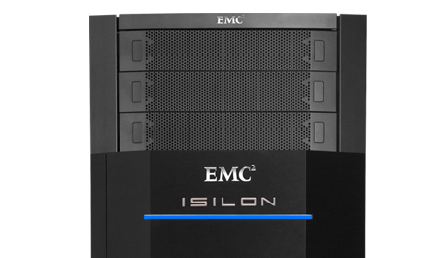
BACKUP SERVER
~ ~
PRIMARY NAS
TAPE ARCHIVES

Slide 6
ZFS DATASET (FILESYSTEM)
ZPOOL
VDEV(RAIDZ2)
…. X 10
P
P
DISKS

Slide 7
SSH tunnel
25623
22
443
Jump host
Secure server

Slide 8
Compute nodes
Compute nodes
NFS server

Slide 9


